Slide 1

PlantAI - Automated Plant Disease Detection Using AI Vision Algorithm
- Puranasree M S
Data Acquisition
Curate a comprehensive and diverse dataset of high-quality images depicting various plant leaf diseases, as well as healthy leaf samples. The dataset should cover a wide range of plant species, disease types, and environmental conditions to ensure the model's robustness. Collaborate with domain experts, such as plant pathologists and agronomists, to ensure the data is representative and suitable for training advanced computer vision models.
Model Development
Design and train highly accurate deep learning models, including Convolutional Neural Networks (CNNs) and Transfer Learning architectures, to effectively learn the visual patterns and features associated with different plant leaf diseases. Explore various model architectures, hyperparameter tuning, and ensemble techniques to achieve the best possible performance on the validation and test sets.
1
2
3
Data Preprocessing
Implement robust data preprocessing techniques to enhance the quality and diversity of the training data, thereby improving the model's generalization capabilities. This includes image augmentation (e.g., rotation, scaling, flipping) to artificially expand the dataset, normalization to standardize the pixel values, and segmentation to isolate the leaf regions from the background.
Key Features
Expected Benefits
Early detection of plant leaf diseases: The system should be able to identify the onset of leaf diseases before they become visually apparent, allowing for timely intervention and prevention.
Improved crop health and productivity: Early detection and accurate diagnosis of leaf diseases can lead to more effective and timely treatment, resulting in healthier plants and higher yields.
Accurate classification of disease types: The model should be capable of precisely classifying the type of leaf disease, enabling targeted treatment and management strategies.
Enhanced decision-making for farmers and agronomists: The system will provide valuable insights and recommendations to support informed decision-making in plant disease management and crop optimization.
Intuitive web-based user interface: Develop a user-friendly interface that allows farmers, agronomists, and researchers to easily upload images, receive disease diagnoses, and access relevant information.

Slide 2
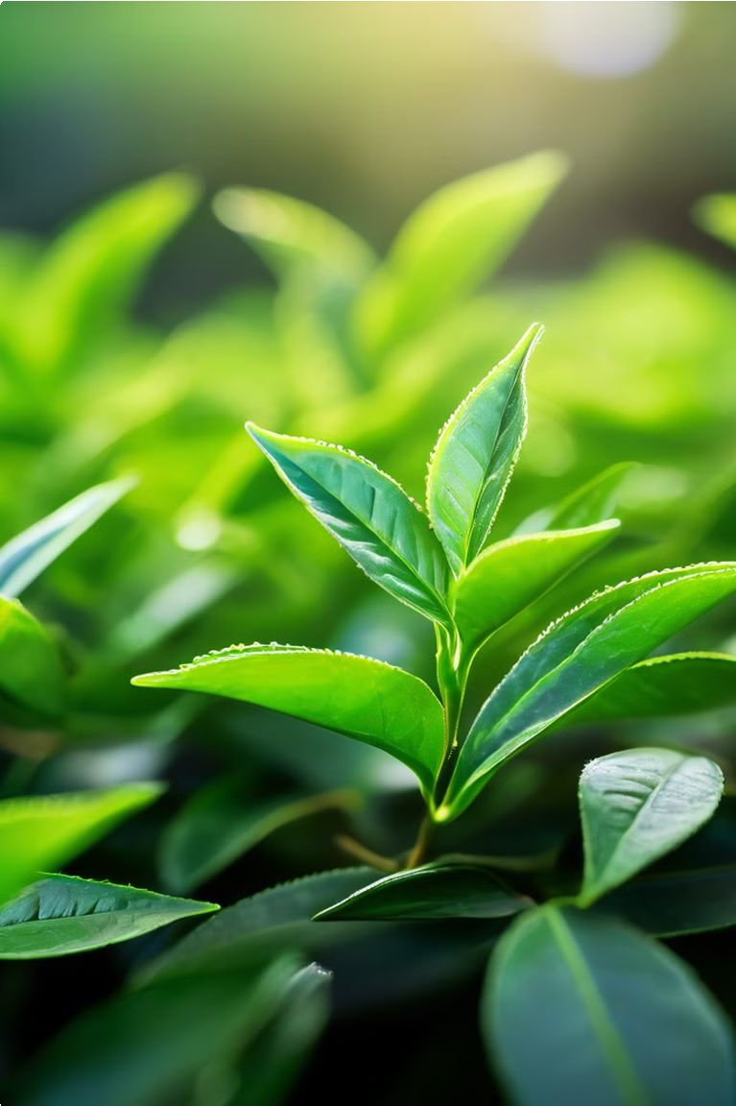
Empowering Precision Agriculture
At the heart of this project lies a bold vision - to create a cutting-edge plant disease detection system that will revolutionize the way we safeguard our agricultural future. By harnessing the power of advanced technology, we aim to equip farmers with the tools to identify and address crop threats early on, nipping potential disasters in the bud. This proactive approach will not only protect precious yields, but also bolster food security for communities worldwide. Prepare to witness the dawn of a new era in precision agriculture, where technology and nature work hand-in-hand to cultivate a bountiful and sustainable harvest.

Slide 3
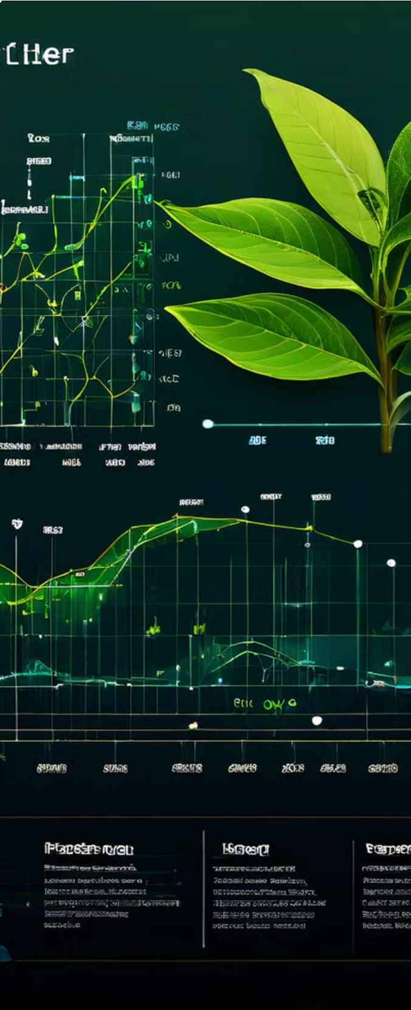
Objectives
The objectives of this project are multi-faceted and aim to address critical challenges in agricultural practices. They are:
To improve the accuracy of plant disease diagnosis, providing reliable and timely insights for informed decision-making.
To minimize crop losses due to diseases, reducing economic burden on farmers and ensuring sustainable agricultural practices.
To enhance food security by enabling efficient disease management and maximizing crop yields.
To facilitate the development of precision agriculture techniques, utilizing data-driven approaches for optimal crop health and production.

Slide 4
Scope
The scope of this project encompasses a wide range of technologies and methodologies. The key areas of focus include:
Image acquisition and preprocessing: Acquiring high-quality plant leaf images and applying various image processing techniques to enhance their quality and prepare them for analysis.
Feature extraction: Utilizing computer vision algorithms to extract meaningful features from the images, highlighting characteristics that differentiate healthy leaves from diseased ones.
Machine learning and deep learning models: Training and deploying robust machine learning and deep learning models, such as Convolutional Neural Networks (CNNs) and ResNet, to classify leaf diseases based on extracted features.
Model evaluation and optimization: Evaluating the performance of trained models using diverse datasets and validation techniques to ensure accuracy and robustness.
User interface development: Creating a user-friendly application that enables seamless interaction, uploading of images, and presentation of disease predictions.

Slide 5
Architecture/Design
The proposed system architecture leverages a combination of powerful libraries and frameworks:
OpenCV: Used for image acquisition, preprocessing, and feature extraction, providing efficient and versatile image manipulation capabilities.
PyTorch: A flexible and powerful deep learning framework for model development, training, and optimization.
TensorFlow: A widely-used and scalable deep learning framework for building and deploying complex models, particularly suited for large-scale datasets.
Keras: A high-level API that simplifies the process of building and training deep learning models, especially for users with varying levels of experience.

Slide 6
Development
The development phase involves implementing and training state-of-the-art deep learning architectures for accurate disease classification:
ResNet: A deep convolutional neural network architecture known for its ability to effectively learn and extract features from images, achieving high accuracy in various image classification tasks.
Convolutional Neural Networks (CNNs): A powerful class of deep learning models specifically designed for image analysis, leveraging convolutional layers to capture spatial patterns and relationships in images.
The chosen models will be trained on a large and diverse dataset of plant leaf images, including both healthy and diseased leaves. This comprehensive dataset will ensure that the models are robust and capable of generalizing to unseen data. The training process will involve careful parameter tuning and optimization to maximize model performance.

Slide 7
Testing
Thorough testing is crucial for validating the accuracy and reliability of the developed system. The following strategies will be employed:
Dataset diversity: The models will be evaluated on a diverse set of images, including those from various plant species, disease types, and environmental conditions, to assess their generalizability.
Cross-validation: Utilizing cross-validation techniques to partition the data into training and testing sets, ensuring that the models are evaluated on unseen data and not overfitting to the training set.
Performance metrics: Assessing the models' performance using various metrics, such as accuracy, precision, recall, and F1-score, to provide a comprehensive evaluation of their classification capabilities.
These rigorous testing procedures will ensure that the system meets the required performance standards and can effectively classify plant leaf diseases in real-world scenarios.

Slide 8
Deployment
The deployment phase involves integrating the trained models into a user-friendly application that can be readily accessed by agricultural professionals and researchers:
User interface design: Creating a simple and intuitive interface that allows users to easily upload plant leaf images and obtain disease predictions.
Model integration: Deploying the trained models on a secure server or cloud platform, ensuring efficient and reliable access to the prediction engine.
Data security: Implementing robust security measures to safeguard user data and ensure the privacy of uploaded images.
Scalability: Designing the system to handle a large volume of requests, ensuring efficient and timely response times even under high demand.
The application will be designed to be accessible via a web browser or mobile app, providing users with a convenient and user-friendly platform for utilizing the plant disease prediction system.

Slide 9
User Guide
A comprehensive user guide will be provided to assist users in utilizing the application effectively and interpreting the results accurately.
Image uploading and processing: Detailed guidelines on how to upload images to the application, including image size, format, and quality recommendations.
Result interpretation: Explanation of the prediction results, providing insights into the identified disease, its severity, and potential management strategies.
Troubleshooting tips: Common issues and solutions to help users resolve any problems they encounter while using the application.
The user guide will serve as a valuable resource for users, enabling them to maximize the benefits of the plant disease prediction system.

Slide 10
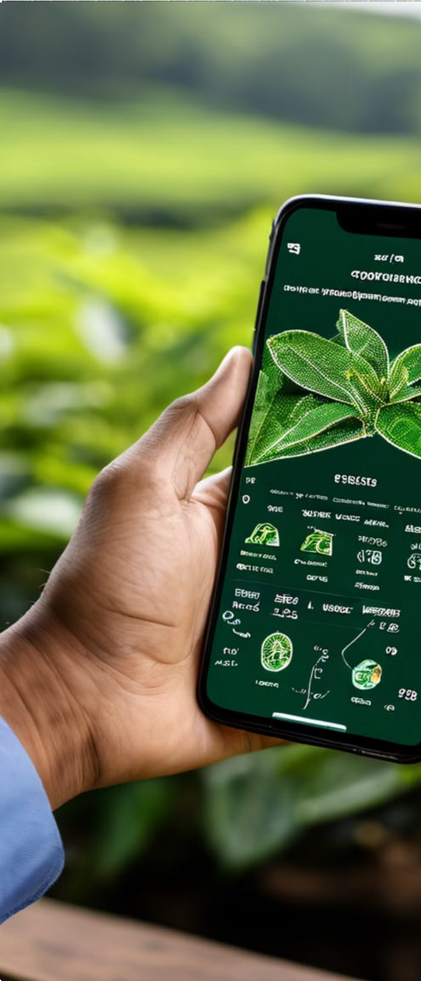
Conclusion
This groundbreaking project aims to develop a robust and highly accurate system for the early detection and classification of plant leaf diseases using advanced machine learning and deep learning techniques. By harnessing the power of computer vision algorithms and cutting-edge neural network architectures, such as ResNet and Convolutional Neural Networks (CNNs), the proposed solution has the potential to revolutionize agricultural practices, dramatically improve crop health, and enhance global food security.
The key anticipated outcomes of this project include:
1
Highly Accurate Prediction System
2
Cutting-Edge Deep Learning Models
3
User-Friendly Application
The creation of a seamless, intuitive, and accessible application that empowers farmers and agricultural professionals to leverage the disease detection capabilities with ease, driving widespread adoption and impact.
The development of a state-of-the-art plant leaf disease prediction system that can accurately identify a wide range of diseases with unparalleled precision, enabling farmers to take swift and targeted action.
Demonstrating the exceptional performance of deep learning models, such as ResNet and CNNs, in the classification of plant leaf diseases, setting a new benchmark for the industry.
To further enhance the proposed system, the project team will explore the integration of multi-modal data sources, such as spectral imaging, and investigate novel deep learning architectures that can unlock even greater predictive accuracy. Additionally, the system will be designed to seamlessly integrate with smart farming systems, enabling automated disease management and optimized resource allocation.
Thank You

